Slide 1

Building Generative Text
Model
December 01, 2024

Slide 2



Introduction
I am AI/ML Engineer working in a US Based Startup having 4+ years of experience and solving financial and litigation problems using artificial intelligence and machine learning.
Ehtisham Raza
AI/ML Engineer and
Data Trainer & Coach at DataTechcon

Slide 3
Todays Agenda
01
Introduction to GenAI
02
Transformers
03
Gemini
04
What is RAG?

Slide 4
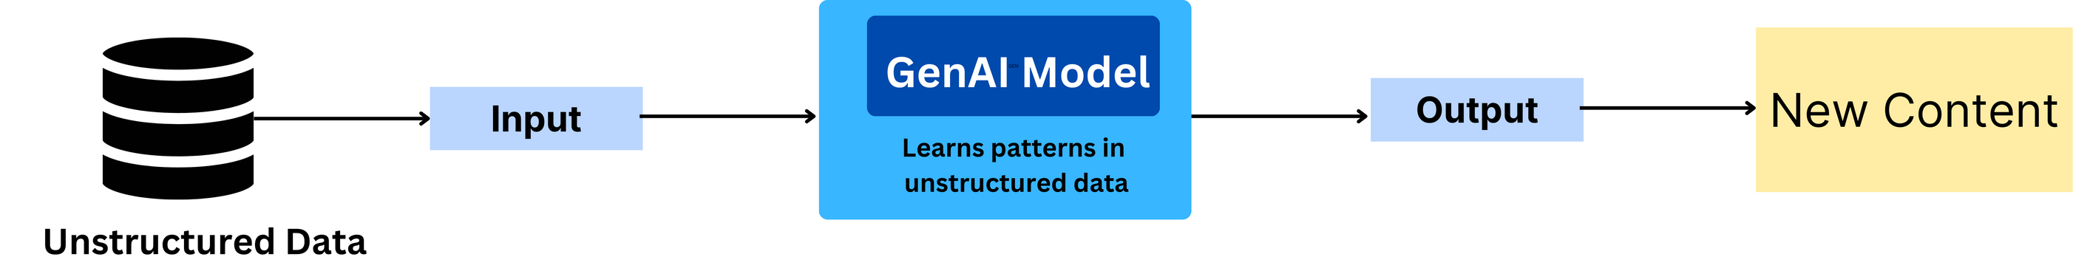
Generative AI
Introduction
Generative Al refers to a set of artificial intelligence methodologies that can produce novel
content that resembles the training data they were exposed to.
The content could be anything spanning from synthesizing text, generating code, realistic images,
music and more
MISSION

Slide 5
Generative AI
Generative Pre-Trained Transformer (GPT) - Motivation
Issues with CNNs, RNNs, LSTMs
Convolutional Neural Networks (CNNs) are good at local feature extraction and struggle to
understand long-range dependencies in data
CNNs do not have a mechanism to understand the order of elements making it harder for
problems involving text and time-series
RNNs especially LSTMs can handle long range dependencies due to their ability to process data
sequentially. But as the sequences get longer, they struggle from vanishing gradient problems
CNNs, RNNs, LSTMs are suitable for specific data types and are not efficient at handling
multi-modal inputs
MISSION

Slide 6
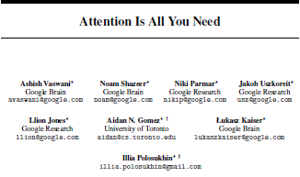
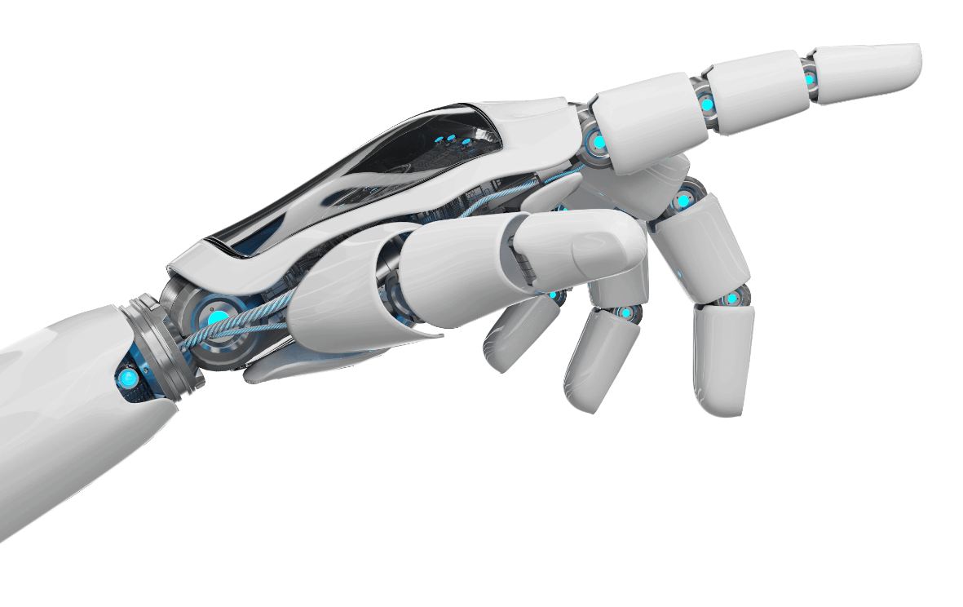
Generative AI
Generative Pre-Trained Transformer (GPT) - Motivation
A new architecture called Transformers is proposed by scientists from Google which
avoids the recurrent connections altogether by relying on an operation known as attention
This architecture also takes care of sequential nature of inputs by using positional embeddings
MISSION

Slide 7
Transformers
What is Transformers?
Transformers are deep learning models designed for handling sequential data by processing the entire sequence at once using an attention mechanism.
Key Components:
Self-Attention: Enables the model to weigh the importance of each part of the input sequence, allowing it to focus on relevant information.
Positional Encoding: Since transformers process data in parallel (unlike RNNs), positional
encoding is used to keep track of the order of words in a sequence.
MISSION

Slide 8
Transformers
What is Transformers?
Advantages:
Parallel Processing: Handles sequences in parallel rather than step-by-step, which improves computational efficiency.
Handling Long-Range Dependencies: Captures relationships between distant words in text,
solving problems traditional models like RNNs face.
Applications:
Natural Language Processing: Transformers power models like BERT and GPT, excelling
in tasks like language translation, summarization, and text generation.
Vision Transformers (ViT): Applied to image processing tasks such as image classification and image captioning.
MISSION

Slide 9
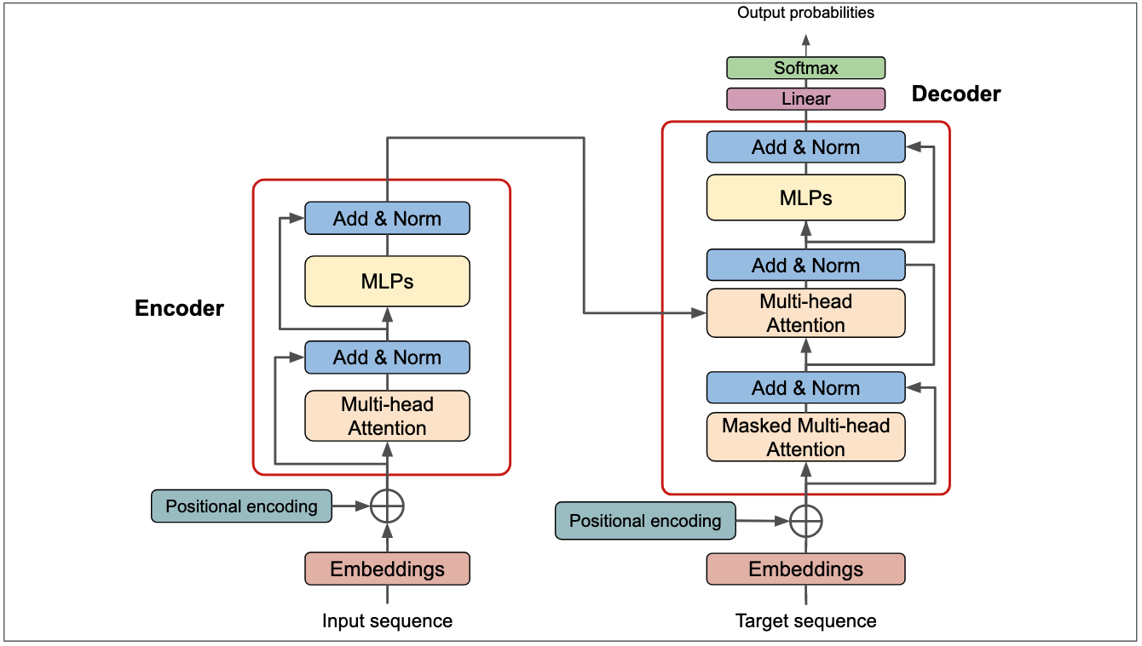
Transformers Architecture
MISSION

Slide 10
Transformers
What is Transformers?
Advantages:
Parallel Processing: Handles sequences in parallel rather than step-by-step, which improves computational efficiency.
Handling Long-Range Dependencies: Captures relationships between distant words in text,
solving problems traditional models like RNNs face.
Applications:
Natural Language Processing: Transformers power models like BERT and GPT, excelling
in tasks like language translation, summarization, and text generation.
Vision Transformers (ViT): Applied to image processing tasks such as image classification and image captioning.
MISSION

Slide 11
What Is Google Gemini?
Gemini, Google's advanced AI model, excels in text, image, video, and audio processing.
It's a versatile multimodal model proficient in complex tasks across mathematics, physics, and more.
Additionally, it can generate high-quality code in various programming languages.
MISSION

Slide 12

Potential Of Gemini
Excelling at competitive programming
Unlocking insights in scientific literature
Processing and understanding raw audio signal end-to-end
Explaining reasoning in math and physics
Reasoning about user intent to generate bespoke experiences
MISSION

Slide 13
Gemini Model Versions and Token Limits
Gemini 1.0 4096
Gemini 1.5 Pro 2,000,000
Gemini 1.5 Ultra 1,000,000
Gemini 1.5 Flash 100,000
MISSION

Slide 14
PaLM 2 vs. Gemini
Feature | PaLM 2 | Gemini
Modality | Primarily text-based | Multimodal (text, code, image, audio)
Reasoning Abilities | Strong language understanding and reasoning | Advanced reasoning and problem-solving
Efficiency | Efficient for text-based tasks | Can be computationally intensive
Applications | Translation, summarization, code generation | Creative content generation, scientific research, education
MISSION

Slide 15
RAG
Advanced LLM Technique
Combines Retrieval & Generation
Retrieves Relevant Information
Enhances Coherent Responses
Context-Aware Outputs
Leverages External Knowledge
Improved NLP Performance
MISSION

Slide 16
Why is Retrieval-Augmented Generation important?
You can think of the LLM as an over-enthusiastic new employee who refuses to stay informed
with current events but will always answer every question with absolute confidence.
Unfortunately, such an attitude can negatively impact user trust and is not something you
want your chatbots to emulate!
RAG is one approach to solving some of these challenges. It redirects the LLM to retrieve
relevant information from authoritative, pre-determined knowledge sources.
Organizations have greater control over the generated text output, and users gain insights
into how the LLM generates the response.
MISSION

Slide 17
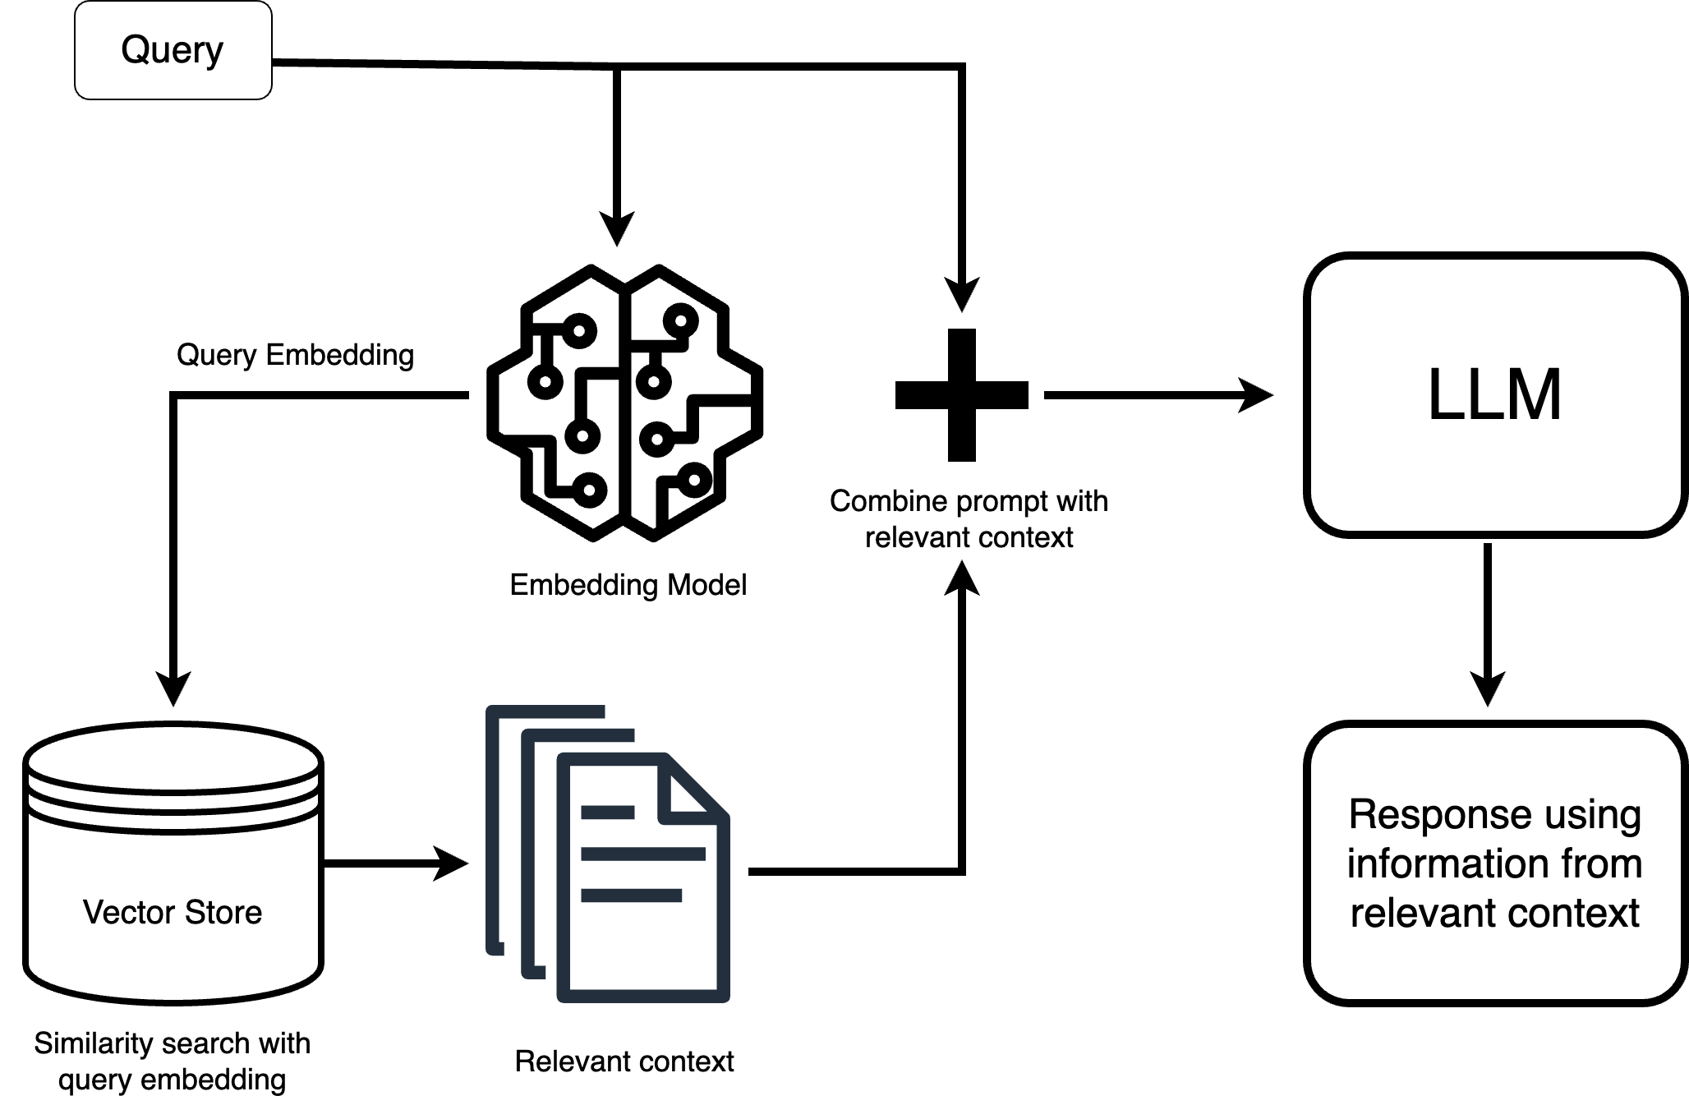
DATA WEEKEND
What make LLM so powerful?
MISSION

Slide 18
THANK
YOU

